Slide 1
Frontend Development

Slide 2
Elements that we will learn today:
dl (Definition List / Description list)
dt (Definition Terms / Definition Type)
dd (Definition Description)
blockquote (The Block Quotation element)
q (Inline Quotation element)
cite (The Citation element)
Notes:
blockquote : (As a verb, to quote means to repeat someone's words, attributing them to their originator. like Quaid Azam's qoutes etc etc.)
q : (The HTML <q> element indicates that the enclosed text is a short inline quotation.)
cite : (The <cite> tag defines the title of a work e.g. a book, a song, a movie, a TV show, etc.)

Slide 3
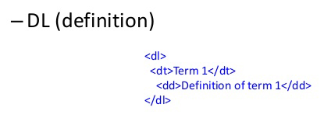

Slide 4
<blockquote cite="http://www.worldwildlife.org/who/index.html"> For 50 years, WWF has been protecting the future of nature. The world's leading conservation organization, WWF works in 100 countries and is supported by 1.2 million members in the United States and close to 5 million globally. </blockquote>

Slide 5
<p>When Dave asks HAL to open the pod bay door, HAL answers: <q cite="https://www.imdb.com/title/tt0062622/quotes/qt0396921">I'm sorry, Dave. I'm afraid I can't do that.</q></p>
When Dave asks HAL to open the pod bay door, HAL answers: “I'm sorry, Dave. I'm afraid I can't do that.”

Slide 6

Assignment
Make a CV using html elements.

Slide 7
References
https://developer.mozilla.org/en-US/docs/Web/HTML/Element/dl
https://developer.mozilla.org/en-US/docs/Web/HTML/Element/dt
https://developer.mozilla.org/en-US/docs/Web/HTML/Element/dd
https://developer.mozilla.org/en-US/docs/Web/HTML/Element/blockquote
https://developer.mozilla.org/en-US/docs/Web/HTML/Element/q
https://www.w3resource.com/html/attributes/html-cite-attribute.php
https://developer.mozilla.org/en-US/docs/Web/HTML/Element/cite

Slide 8
